Slide 1
Day 1: Lets Play with Data!
2008 Presidential Election Donations

Slide 2
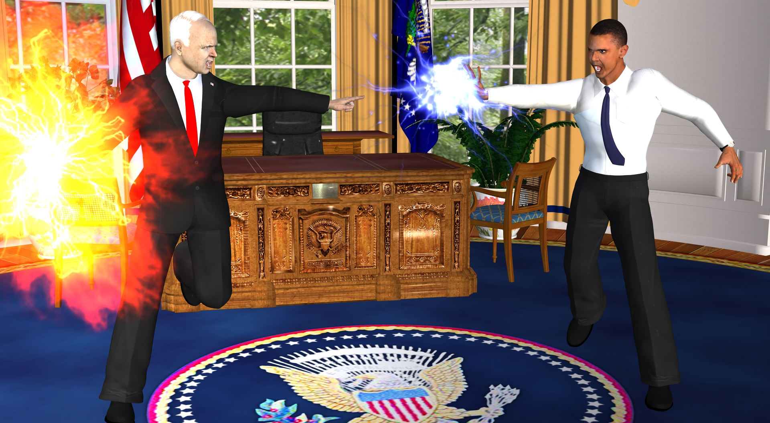

Slide 3
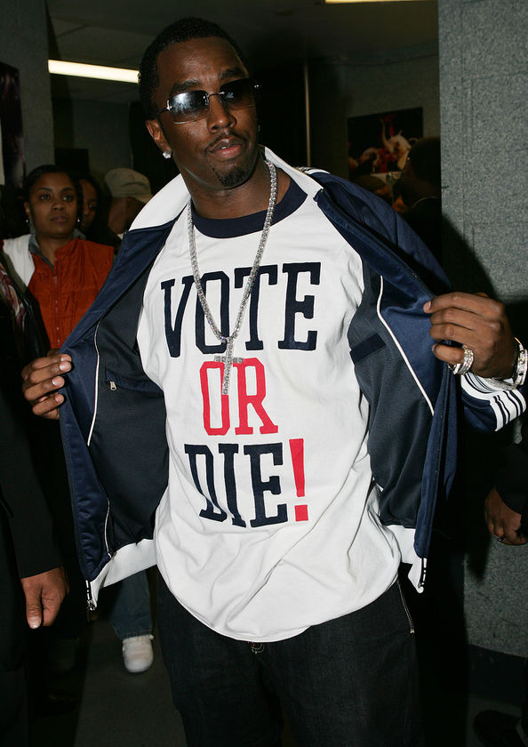

Slide 4
$1,644,712,232

Slide 5
6X
Earth’s circumference!

Slide 6
10%
U.S. Dept of Energy’s Budget!

Slide 7
Federal Election Commission
(FEC)

Slide 8
2008 Donations Dataset
C00430470,"P80002801",
"McCain, John S",
"WAHLERS, STUART E. MR.",
"A.P.O.", "AE", "091280013",
"U.S. MILITARY","SOLDIER",
250, 31-JUL-08,
"","X",
"TRANSFER FROM MCCAIN VICTORY 2008",
"SA18",377957

Slide 9
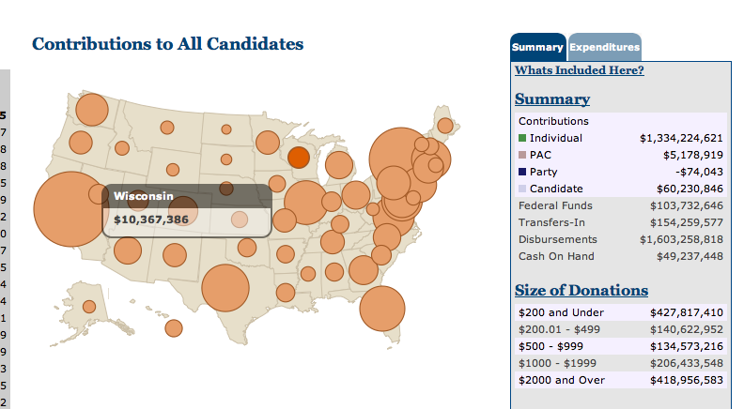

Slide 10


Slide 11


Slide 12


Slide 13
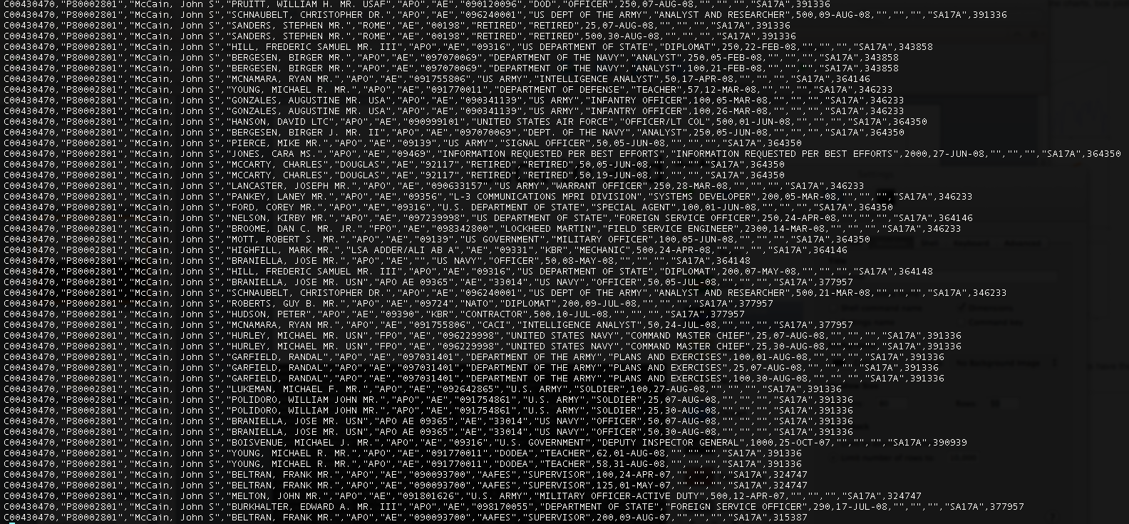

Slide 14
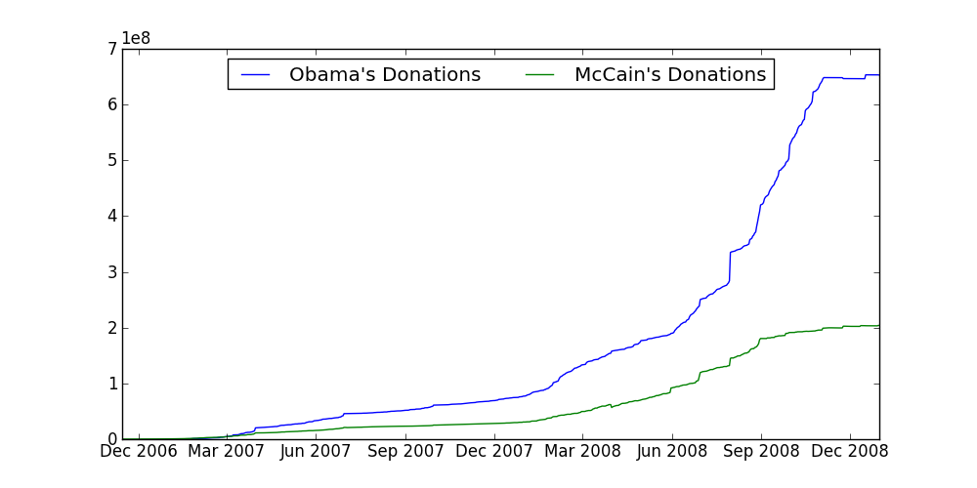

Slide 15
Negative Donations

Slide 16
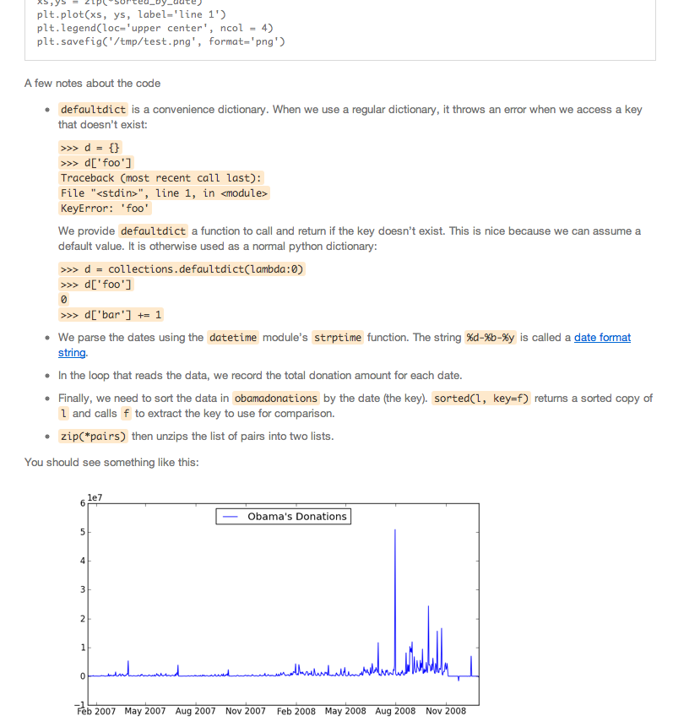

Slide 17
dataiap.github.com/dataiap/day1/

